Slide 1

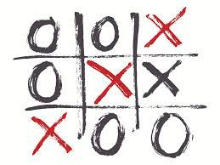

TicTacToe By: Brandon Gunn
A fun game that you will be able to play with your friends and family.
https://github.com/ksu-is/TicTacToe

